Slide 1
Credit Scorecard
By : Amol Murme
Asso.Data Scientis, Cognext.ai

Slide 2
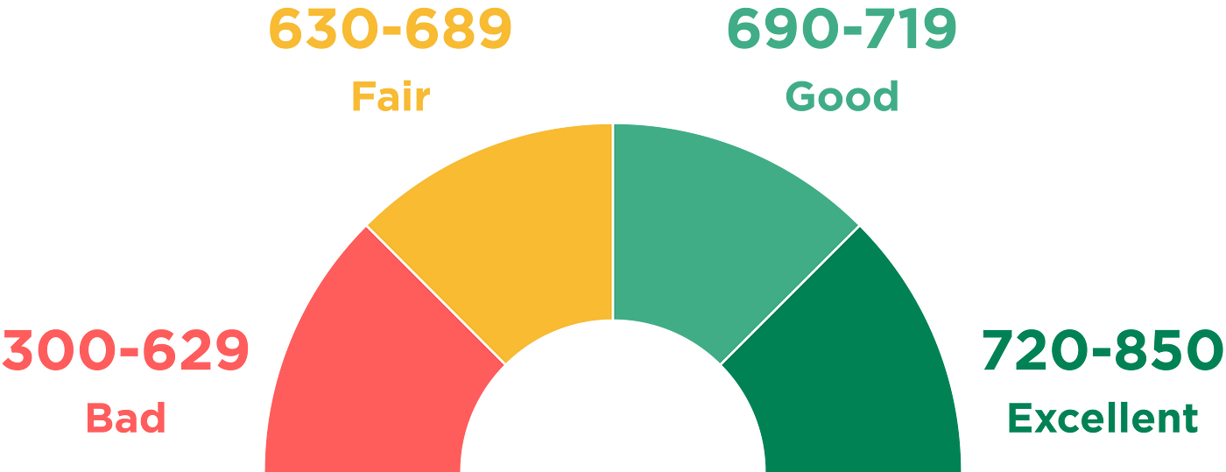
Scorecard
A credit scorecard is essentially a tool used by lenders to evaluate the creditworthiness of an individual or entity. It's like a report card for your financial behavior, summarizing your credit history and providing a numerical score that indicates the likelihood of you repaying debts responsibly.
You

Slide 3
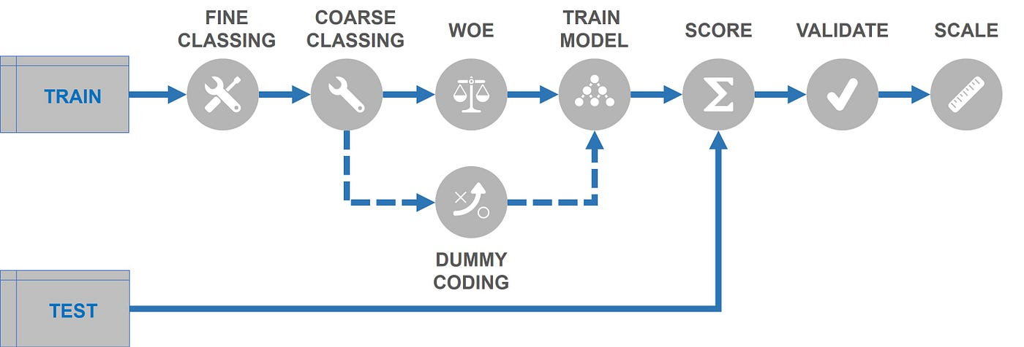
General Workflow

Slide 4
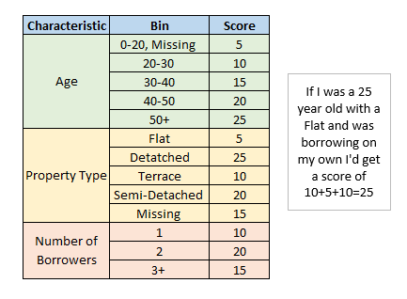
Mock Scorecard
Binning
The process of binning or grouping continuous variables into discrete categories. This helps simplify complex data and allows for easier analysis and interpretation in credit scoring models. For example, age could be binned into categories like "20-30," "30-40," "40-50," and so on, to capture different risk profiles associated with different age groups.

Slide 5

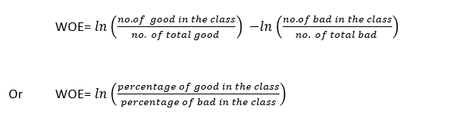
Weight of Evidence

Slide 6
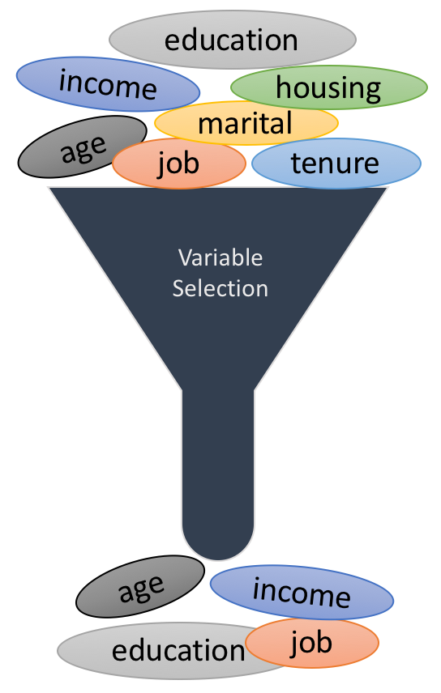
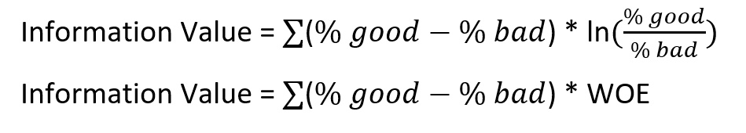
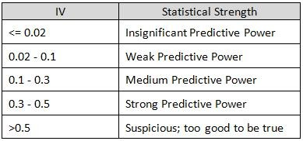
Information Value

Slide 7
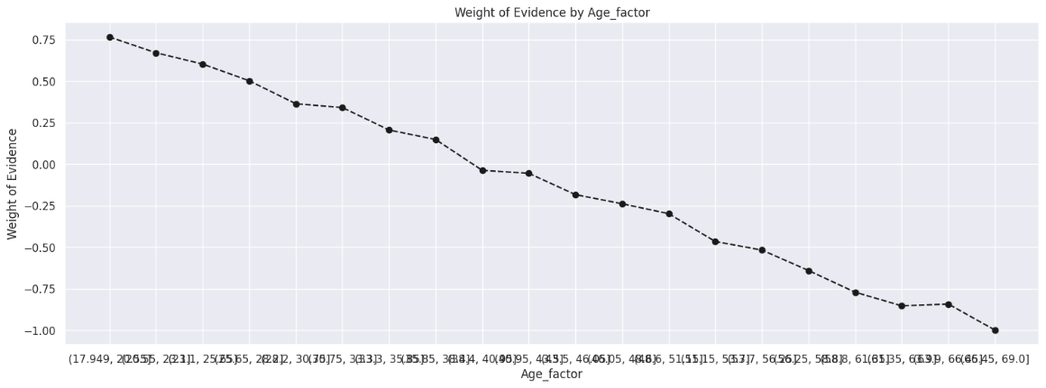
Fine Classing
Create 10/20 bins/groups for a continuous independent variable and then calculates WOE and IV of the variable

Slide 8
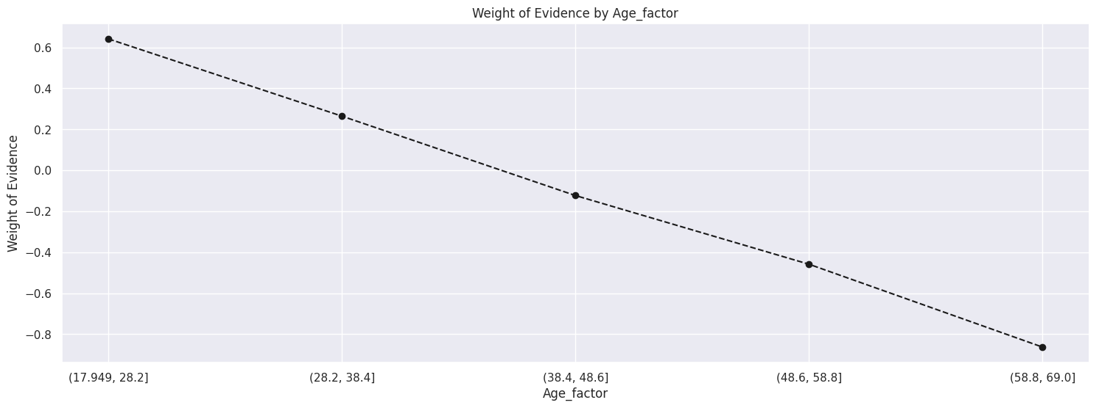
Coarse Classing
Combine adjacent categories with similar WOE scores

Slide 9

Thank you

